Slide 1
When should humans overrule AI?
Veronika Moroz
DE5 class
CodeClan
09 Nov 2020
Notes:
Hi,
I am going to speak about - When should humans overrule AI?

Slide 2
Overview
Cases
Summary
Challenges
Possible solutions
Conclusion
Notes:
Overview
I am going to cover some cases which involved failure of AI. Short sum...challenges that faces...possible solutions and finally, I will conclude it.

Slide 3
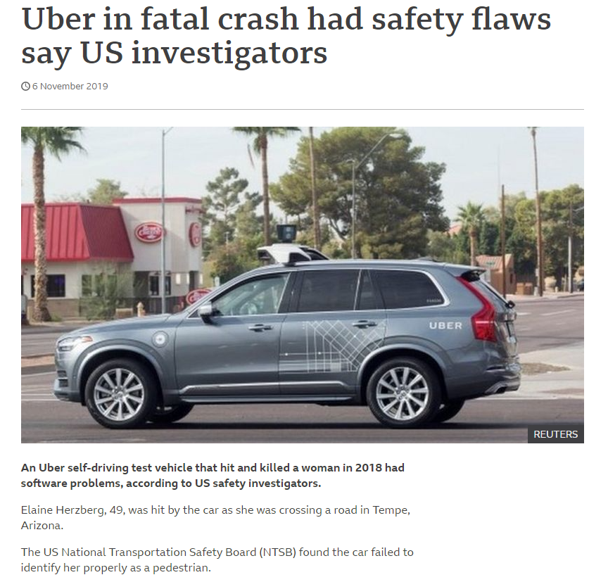
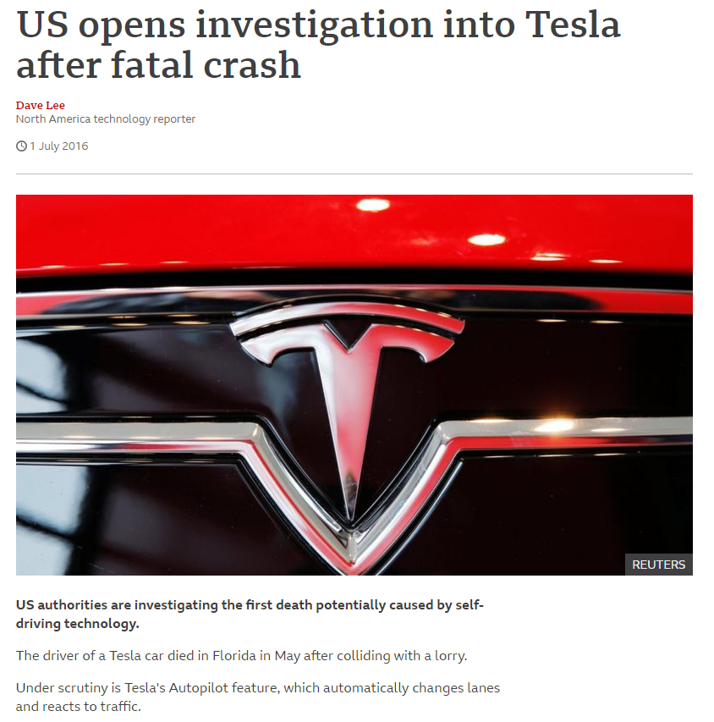
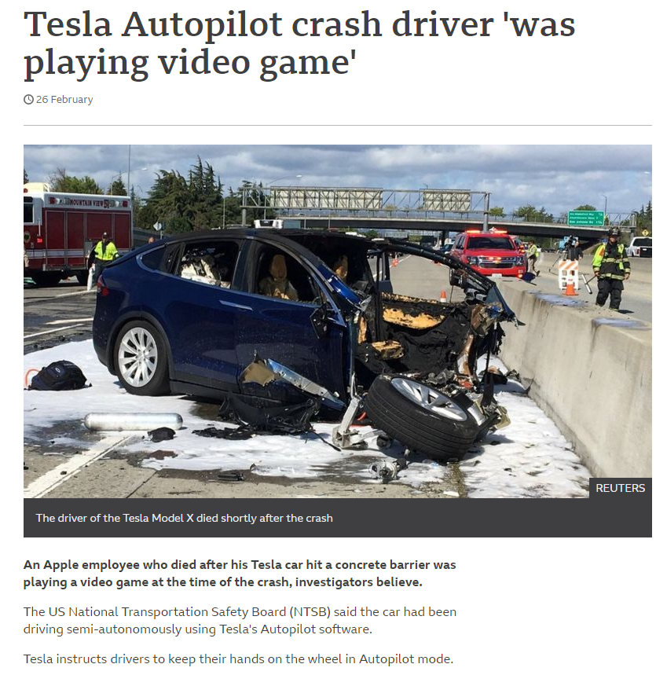
Cases
Notes:
There were a couple of cases when due to error or malfunction in AI...caused fatal outcomes.
In 2018 the first pedestrian killed by a self-driving car. It happened in Arizona. After this incident, Uber ended its testing of technology there and it did not renew permits for testing in California in that year.
Safety driver had been watching a television show.
In 2016, 2 year earlier a driver had been killed by a semi-autonomous car. Beginning this year, there was an accident as well which ended up sadly.

Slide 4
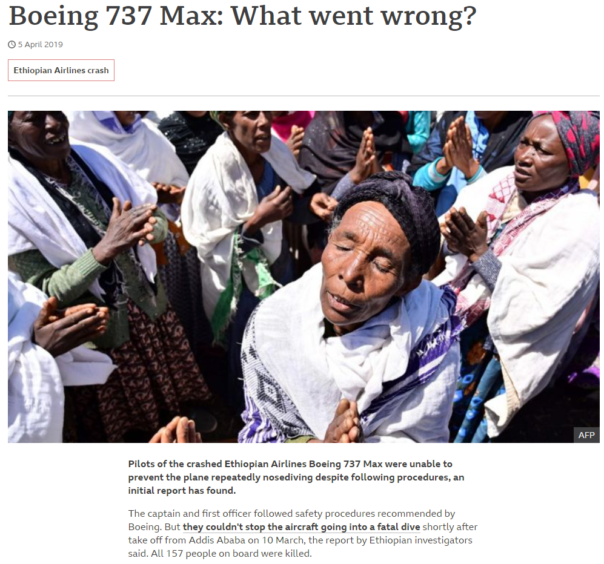
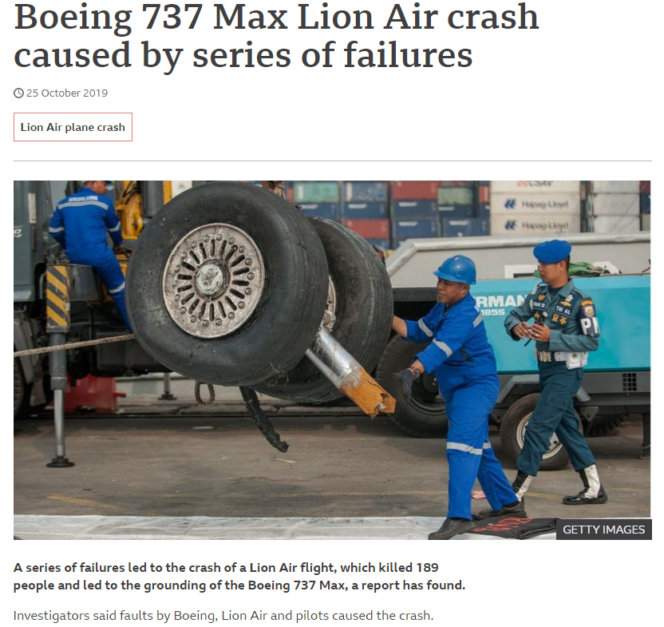
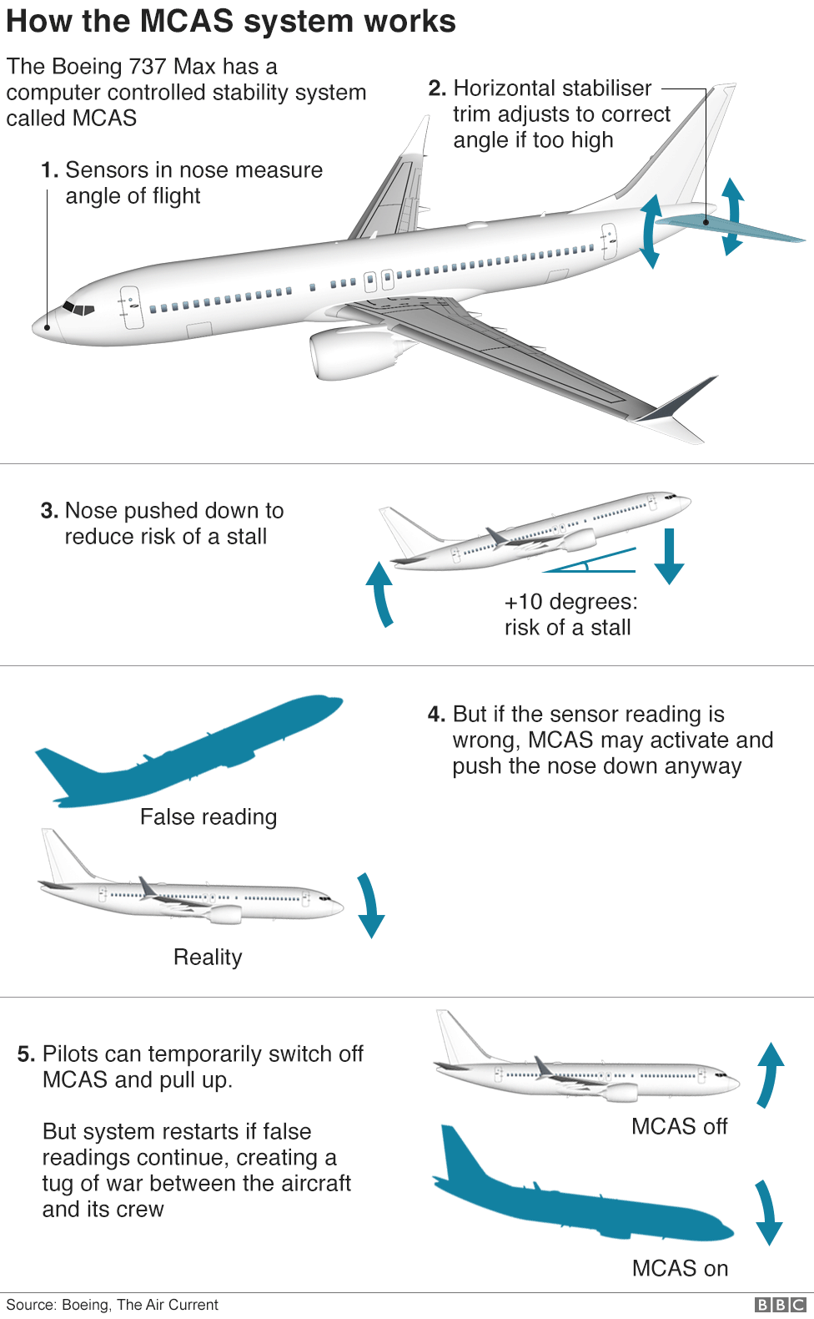
Notes:
From Oct 2018 within 6 months, similar plane crashes of Boeing 737 MAX. Reports suggested that this happened due to aggressive changes in AI systems built for safety. The automated system MCAS and sensors on the plane caused planes to push the nose down despite pilots ' resistance to push it up. Pilots also lacked training with this system. Unfortunately, no one survived.

Slide 5
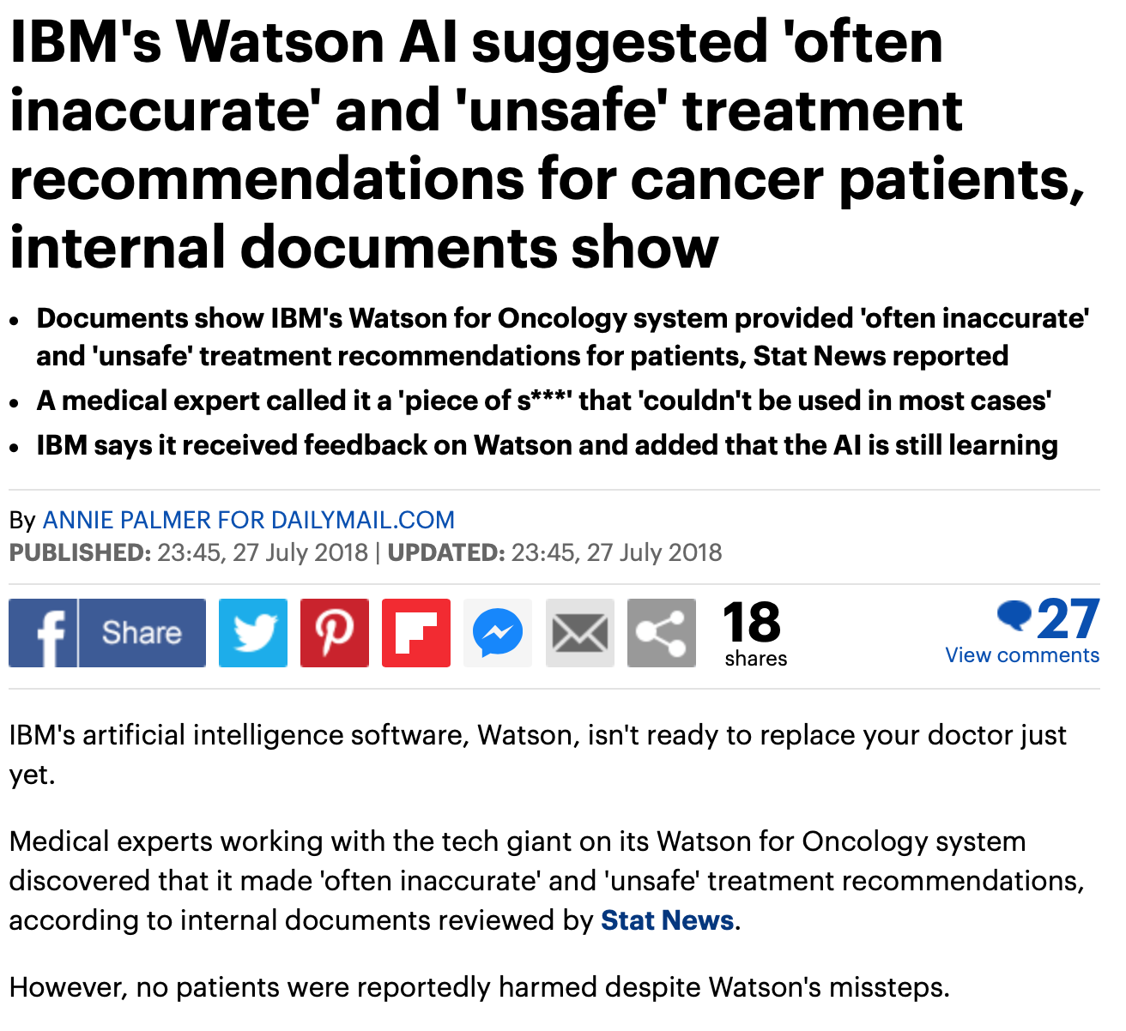
IBM’s “Watson for Oncology” Cancelled After $62 million and Unsafe Treatment Recommendations
In 2013, IBM partnered with The University of Texas to develop a new “Oncology Expert Advisor”.
In July 2018, it was found that IBM’s Watson was making erroneous and dangerous cancer treatment advice.
Case where Watson suggested that doctors give a cancer patient with severe bleeding a drug that could worsen the bleeding.
Notes:
Not fatal but close enough. In 2013, IBM partnered with The University of Texas to develop a new “Oncology Expert Advisor” system to cure cancer using a research database.
In July 2018, after reviewing docs it was found that IBM’s Watson was making erroneous, downright dangerous cancer treatment advice. IBM’s engineers. Evidently, they trained the software on a small number of hypothetical cancer patients, rather than real patient data.
identified “multiple examples of unsafe and incorrect treatment recommendations,” including one case where Watson suggested that doctors give a cancer patient with severe bleeding a drug that could worsen the bleeding. Fortunately, no one was harmed.

Slide 6
In summary
AI is perfect but still has its own issues.
People lost oversight.
Nowadays, people's growing dependence on algorithms.
AI is the instrument and has its limits.
People tend to rely on others if responsibility is too heavy for us.
While we can delegate decision making to machines, we can't delegate responsibility
Notes:
In short summary of all these cases. As we can clearly see, AI isn’t without its issues as it was made by humans. What do these three cases have in common?
People did not intervene in the operation of the machines and this led to a disaster. People lost oversight.
Assistance systems are designed help to avoid pilot errors, especially in stressful situations such as a climb shortly after take-off. Usually, these systems are highly effective. But when they're faulty, they're often fatal. We've seen this happen in numerous (near) crashes. There is a risk people's growing dependence on algorithms would eventually erode their ability to think for themselves. However, AI has its limits based on the data it was trained on and sometimes it is impossible to predict what can be in the future.
In general, people tend to rely on outsourcing (to machines or other humans) when we feel the responsibility is too heavy for us. "There have been reports on mis-policing or mis-judgment in legal systems or decisions on loans and financial support in banking systems that involved outrageous mistakes.While we can delegate decision making to machines, we can't delegate responsibility.

Slide 7
Challenges
How to build an understanding of personal limitations into code?
Whose final decision? Machine or human?
Fully understand the systems.
Working in tandem with machine.
What happens if incompetent AI is paired with an equally incompetent human?
Notes:
So challenges are If a human worker needs help, they can ask for it — but how do you build an understanding of personal limitations into code?
Artificial intelligence (AI) could be used to collect crucial information from an enormous amount of data and, if necessary, identify patterns. Whose final decision? For people, such as a stressed pilot, artificial intelligence could then filter out the decisive facts that they must base their decision on. People must have the power to make the final decision. AI should only act as an assistant, and the machine should not have primary control.
In both crashes, the commonality was that the autopilot did not understand its own incompetence. Plus, humans working with or accountable for AI need to fully understand the systems they're working with. to understand what's going on in the black box. There is a risk that humans won't simply be overseeing AI, helping out a system when it admits it's incompetent.
Instead, such systems and humans will work in tandem, helping each other with their blind spots. "It might be that a human doesn't catch something, but the algorithm does, or the other way around," she says. "I think having the idea that a human always has to overrule or an algorithm always has to overrule is not the right strategy. It really has to be focusing on what the human is good at and what the algorithm is good at, and combining those two things together. And that will actually make decision making better, more fair and more transparent."

Slide 8
Potential solutions
Regulatory oversight by government:
EU Commission's white paper
UK's Committee on standards in public life
In the US, the Pentagon released guidelines on the ethical use of AI for military purposes.
Does not overcome innate human flaws.
Solution? ‘Human-centric’ approach!
Could combine the best of both.
Notes:
Beginning of 2020.
Artificial intelligence, for all its benefits, needs human oversight. Government reports, and experts all over the world have stressed the importance of keeping a human decision-maker in the loop when using AI.
"Human agency and oversight" is the first key requirement laid out in the EU Commission's white paper on the regulation of AI published earlier this month; and establishing oversight of "the whole AI process" is also a recommendation from the UK's Committee on standards in public life. having human workers always making final decisions in policing, rather than letting new technologies overrule officers' authority.
In the US, the Pentagon released guidelines last year on the ethical use of AI for military purposes. Among the chief recommendations, the document also features the need for an "appropriate" level of human judgement whenever deploying an autonomous system.
having a human overseeing an AI system does not entirely solve the problem – because it doesn't do much to overcome innate human flaws. According to Fry, we place excessive trust in AI systems with consequences that can sometimes be dramatic.
The solution, lies in adopting a "human-centric" approach when developing new technologies; in other words, an approach that accounts for human flaws. The mathematician advocated for a "partnership" between humans and machines that could combine the best of both – while also ensuring that there is always space for humans to question the algorithm's results.

Slide 9
In conclusion
Interaction between people and machines must be improved.
Must ensure that people actually understand the algorithm and are able to control it.
Make big data easy.
Relate to AI as a tool and work with machines.
Don’t forget that it was made by the same people as you.
Trust, but verify!
Notes:
I think..
In the future, the interaction between people and machines must be improved.
We must ensure that people are actually able to control the machine and that pilots, mechanics, airlines, manufacturers or supervisory authorities can always make safe decisions when in doubt.
One of the issues businesses have with big data is finding ways to make sense of it. With so much information to sort through, discovering how to interpret and apply findings is difficult.
we should shift our mindset and think about ways to work with machines. This is a great opportunity for us to think deeply about what we are good at, what we really want to do, how we can better leverage machines!

Slide 10
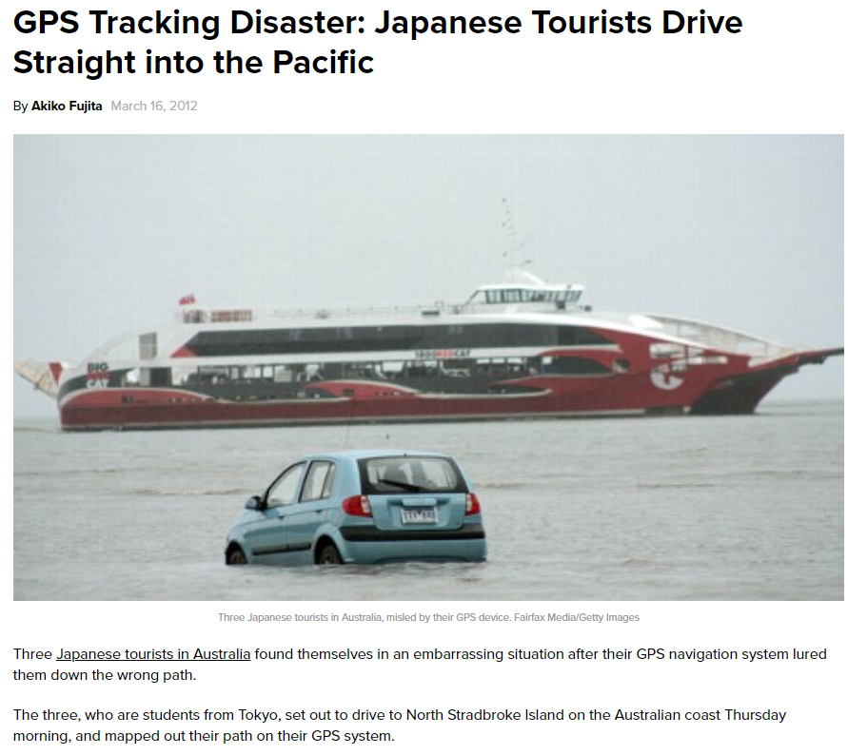
Notes:
Or we ended up like these three tourists found themselves diving into Oceans. our trust in technology can come at a much greater cost, for example when we get to relying on self-driving cars.

Slide 11
References
https://www.zdnet.com/article/ai-needs-to-be-controlled-but-lazy-humans-may-not-be-up-to-the-job/
https://www.wired.co.uk/article/ai-decision-making
https://readwrite.com/2020/07/31/failure-in-artificial-intelligence/
https://www.mckinsey.com/business-functions/mckinsey-analytics/our-insights/confronting-the-risks-of-artificial-intelligence#
https://www.wired.co.uk/article/ai-decision-making
https://www.dw.com/en/boeing-crash-can-machines-make-better-decisions-than-people/a-47920904

Slide 12
Thank you!
Any Questions?

